Slide 1


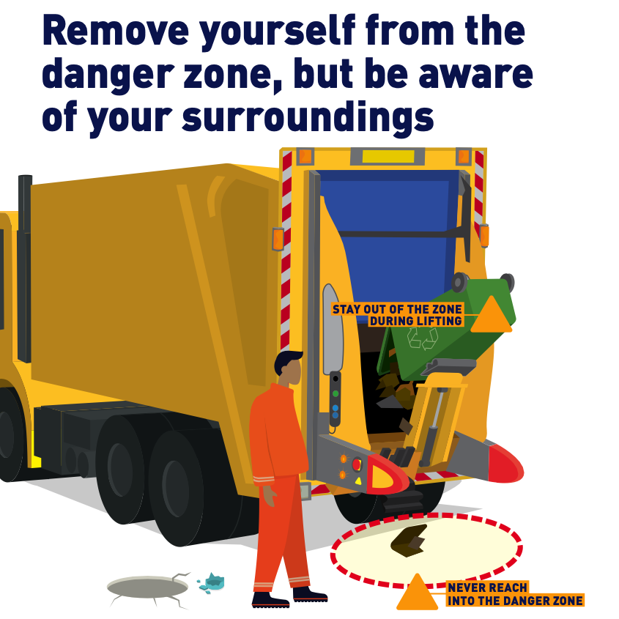
Bin Lift Equipment
HUDDLE CARD
FEBRUARY 2024
Introduction
This campaign is targeted at users of refuse collection bin lifters and wheeled bins used for the collection of domestic and trade waste. Wheeled refuse collection bins (both domestic ‘wheelie bins’ and larger sized trade waste bins) and vehicle mounted bin lifters have been in use in the UK since the mid1980s. Despite technological developments and collective experience with this equipment, significant numbers of serious accidents, including deaths, still occur.
We often refer to the Danger Zone which is the area in between the barrier arms or directly behind the vehicle hopper. This is where safe standing positions need to be defined for workers during the tipping cycle.
Never put yourself or allow anyone else to be placed in Danger, stay aware of your surroundings the situation, and stay in control. Remember no job is so important that we cannot take the time to do it safely
Scan the QR code to access the digital campaign content

Slide 2
Huddle Outcomes
No job is so important we cannot take time and do it safely
What is the danger zone?
What accidents could happen within the danger zone?
Why do we not stay within the danger zone when emptying waste containers?
How do I keep the apparatus and mechanicals in good working condition?
What should I be aware of when working on the road and pavement?
We look out for and trust each other.
What would I do if I saw a colleague not following the procedures and putting themselves in a hazardous situation within the danger zone?
We share and seek ideas for improvement.
Discuss how waste containers become damaged and what we can do to prevent harm to the next person using it?
Confirmation
Developed by |  | Hosted by
Date hosted |  | Host signature
I have been in attendance for the huddle discussion hosted by the person named above and have understood the subject fully and can implement any actions arising from the information provided and discussed.
Name | Date | Signature

